Slide 1
SAP FINANCIALS Asset Accounting: Periodic Processing & Reporting

Slide 2

Asset Accounting
Information system /Reporting
Periodic processing
Asset Transactions
Master data
Organization structure

Slide 3
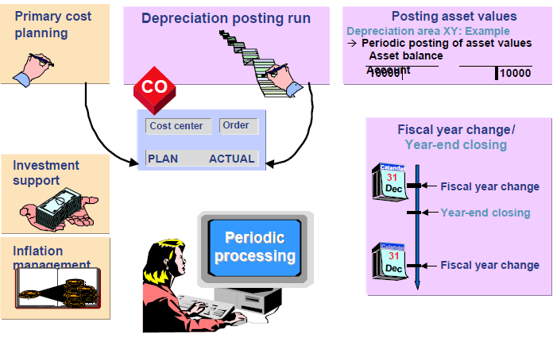
Asset Accounting : Periodic Processing
Periodic processing comprises the tasks in Asset Accounting that must be performed at periodic intervals.

Slide 4
Asset Accounting : Periodic Processing
For planning primary costs on a cost center basis, you can periodically determine planned depreciation and interest and pass these on to primary cost planning in the CO system via a report.
Investment support is a subsidy that a company receives for certain asset investments. Assets that are eligible for such a subsidy are marked in the asset master records with an investment support key. All specifications for claiming the investment support are stored in the definition of this key. The claim can be posted manually or in a mass procedure.
Inflation management is required in countries with high rates of inflation or deflation.
The Schedule Manager in FI-AA can be used to define, schedule, process, and control periodically recurring processes

Slide 5
Periodic processing : Depreciation
The system supports the following direct types of depreciation:
Ordinary depreciation: This is the planned reduction in asset value due to normal wear and tear.
Special depreciation: This represents a purely tax-based type of depreciation for wear and tear where the percentage may be staggered within a tax concession period, without taking the actual wear and tear on the asset into consideration.
Unplanned depreciation: This is concerned with unusual circumstances, such as damage to the asset, that leads to a permanent reduction in its value.
Unit-of-production depreciation: This takes fluctuations in activity into account for the depreciation calculation. It makes the amount of depreciation dependent upon seasonal usage of the asset (for example, number of miles traveled or units produced).

Slide 6
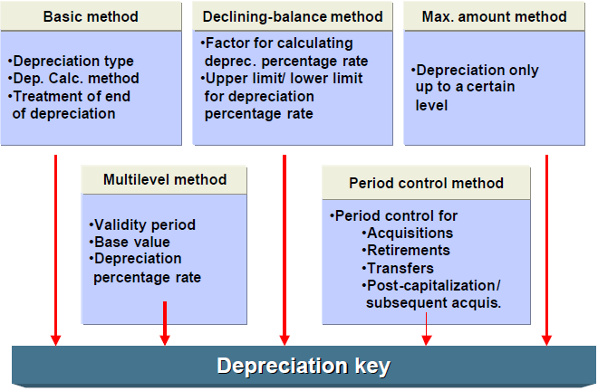
Periodic processing : Depreciation
Specifications and parameters that the system requires to calculate depreciation amounts are entered in calculation
Calculation methods can be assigned to a depreciation key.
Notes:
Advantages of using calculation methods:
. Country-specific requirements are represented by methods specific to a
particular chart of accounts.
. They allow you to avoid the use of an ever-increasing number of internal
calculation keys.
. You can enter depreciation keys as default values for a particular company
code or depreciation area.
2

Slide 7
Periodic processing : Depreciation process
The asset master record contains the depreciation terms which calculate the annual depreciation using the depreciation key and the useful life.
According to the purpose of the depreciation area, other terms, such as revaluation or imputed interest, are also calculated.
The system determines the depreciation start date using the asset value date and the period control method.
The Asset Explorer displays the values and the depreciation for every transaction and each area and also the calculation of depreciation values.
Note :Changing the Customizing definition of the depreciation keys does not automatically lead to a correction of depreciation values that have already been calculated for individual assets. For that to happen, recalculation of depreciation has to be executed.
Notes:
Advantages of using calculation methods:
. Country-specific requirements are represented by methods specific to a
particular chart of accounts.
. They allow you to avoid the use of an ever-increasing number of internal
calculation keys.
. You can enter depreciation keys as default values for a particular company
code or depreciation area.
2

Slide 8
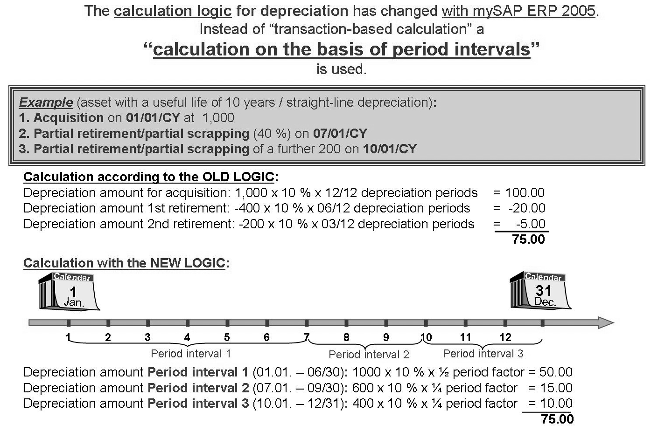
Depreciation: Depreciation engine
Calculation on basis of period intervals
In many cases the new calculation program calculates the same depreciation amount as the old logic. However, the new Depreciation Engine does, in principle, enables a more precise calculation.

Slide 9
Depreciation: Time dependent dep terms
The following parameters can be changed on a time dependent basis :
Depreciation key
Useful life (year /period)
Variable depreciation amount
Absolute scrap value
Percentage scrap value
With the use of time-dependent intervals (in conjunction with the new mySAP ERP Depreciation Engine) depreciation can be calculated more accurately than was previously possible.
If time-dependent depreciation terms are not used, a change would have the effect that all open (and future) fiscal years are recalculated. See example …

Slide 10
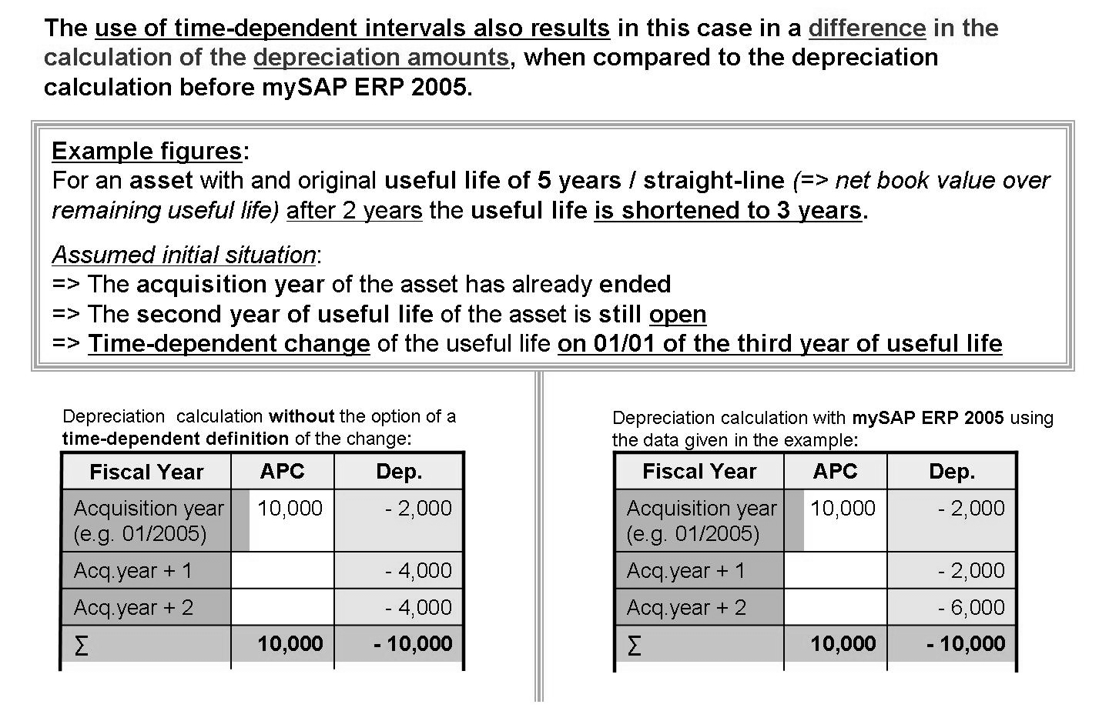
Depreciation: Time dependent dep terms

Slide 11
Depreciation : Cost accounting Area
It can be defined whether interest should be calculated for the cost-accounting depreciation area, and whether depreciation should continue below zero. These specifications can be made while defining the depreciation areas.
Automatic calculation:
Depreciation after planned life end :Depreciation is continued after the end of the planned useful life.
Depreciation below book value: Depreciation is continued after the book value is zero. The depreciation area must allow negative net book value (a changeover key may be used).
Effective life after planned end (with curb): The actual, not the planned life determines the rate of depreciation.
Example: The useful life is 10 years, so there is depreciation of 1/10 each year. This indicator reduces the depreciation rate of 1/10 of the APC to 1/11 in the 11th year, and so on, so that the depreciation amount decreases after the planned end.

Slide 12
Depreciation: Imputed Interest
For cost accounting, calculation of imputed interest on the capital tied up in assets can be done. Specify the following settings:
Allow the calculation of imputed interest for the depreciation area.
Determine that interest should be posted for the company code and the corresponding depreciation area.
Use a depreciation key to which calculation methods for the depreciation type Interest are assigned, or define such a key yourself.
If the calculation of the interest is based on a replacement value, the system calculates indexed interest.
The system posts interest simultaneously during the periodic depreciation posting run. It posts to the accounts that are entered in the relevant account determination for each depreciation area. Furthermore, an additional account assignment can be made to the cost center or the internal order entered in each asset master record (as is the case with depreciation).

Slide 13
Depreciation: Replacement values/Indexing
If revaluation (indexing) is used in a depreciation area, the index series should be entered in the asset or in the asset class for calculating the replacement value
The index series must be assigned to an index class. This class contains the essential control parameters for the index series. Only year-dependent index classes are used.
Index figures for the index series have to be specified for each fiscal year. If they are missing, the system switches to the simulated annual rate of revaluation.
An indexed revaluation can also be calculated for accumulated depreciation and imputed interest (if the interest calculation key is based on replacement value).
Specify in the depreciation area if you want to post to the general ledger, indicating whether you want to post revaluation of APC only, or also include depreciation/interest

Slide 14
Depreciation: Depreciation Process
The program RAPOST2000 directly posts to the G/L accounts and additional account assignment objects. Using a test run, you can check for any possible errors (such as locked cost centers). Any errors that occur are displayed in an error list.
Only real CO account assignment objects can be posted. However, you can make additional, statistical postings to other objects.
The following can be posted
Ordinary depreciation (book depreciation and cost-accounting)
Tax depreciation, or allocation and write-off of reserves due to special tax depreciation
Unplanned depreciation (or other manually planned depreciation)
Imputed interest
Revaluation of APC or of accumulated depreciation

Slide 15
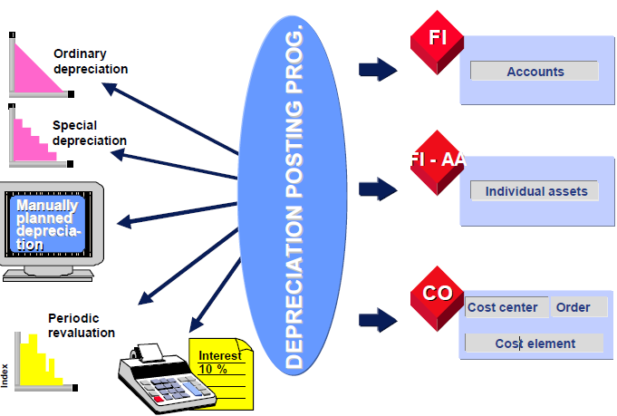
Depreciation: Depreciation Process
Notes:
The menu paths for these settings are:
. For 1.: In Customizing for Asset Accounting, choose Valuation →
Depreciation Areas → Define Depreciation Areas
. For 2: In Customizing for Asset Accounting, choose Integration with the
General Ledger → Assign G/L Accounts
. For 3.: In Customizing for Asset Accounting, choose Integration with the
General Ledger → Post Depreciation to the General Ledger → Specify
Document Type for Posting of Depreciation → Specify Document Type for
Posting of Depreciation
. For 4.: In Customizing for Asset Accounting, choose Integration with the
General Ledger → Post Depreciation to the General Ledger → Specify
Intervals and Posting Rules
Select the company code and depreciation area in the dialog structure.
. For 5.: In Customizing for Asset Accounting, choose Integration with the
General Ledger → Additional Account Assignment Objects → Activate
Account Assignment Objects
. For 6.: In Customizing for Asset Accounting, choose Integration with the
General Ledger → Additional Account Assignment Objects → Specify
Account Assignment Types for Account Assignment Objects
. There is a program that shows all active account assignment objects:
RAACCOBJ01 ( v transaction: AACCOBJ)
1

Slide 16
Periodic Processing :FY change and YE closing
Fiscal year change (T Code AJAB )
A fiscal year change represents the creation of a new fiscal year for a company code. At the fiscal year change, the asset values from the previous fiscal year are carried forward cumulatively into the new fiscal year.
Once the fiscal year change takes place, you can post to assets using value dates in the new fiscal year. At the same time, you can, however, continue to post in the previous fiscal year, provided this has not been closed as a result of the year-end closing.
The earliest that you can carry out a fiscal year change is in the last month of the old fiscal year.
Before you can change to fiscal year YYYY, you must have already closed fiscal year YYYY-2. You can have a maximum of two fiscal years open for posting at one time.
The fiscal year change has to be carried out as background processing for performance reasons

Slide 17
Periodic Processing :FY change and YE closing
Year end closing (T Code AJRW )
The fiscal year change has to be carried out in Asset Accounting before the year-end closing (SAP FI-AA).
The system only closes a fiscal year in a company code if
The system found no errors during the calculation of depreciation (such as incorrectly defined depreciation keys)
Planned depreciation from the depreciation areas to be posted has been completely posted to the general ledger
Balances from depreciation areas that are posted periodically have been completely posted to the general ledger
All assets acquired in the fiscal year have already been capitalized. Since this check does not make sense for assets under construction, you can prevent it from being performed for these assets by means of the asset class.
All incomplete assets (master records) have been completed.

Slide 18
Periodic Processing :FY change and YE closing
Year end closing (T Code AJRW )
Once the fiscal year is closed, you can no longer post or change values within Asset Accounting (for example, by recalculating depreciation).
You can undo a year-end closing that has already been performed if you establish that fixed assets do have to be corrected after all.
The fiscal year that is closed is always the year following the last closed fiscal year. You cannot close the current fiscal year.
The year-end closing in Asset Accounting must be performed before the year-end closing in General Ledger Accounting.
You have to carry out the year-end closing as background processing for performance reasons.

Slide 19
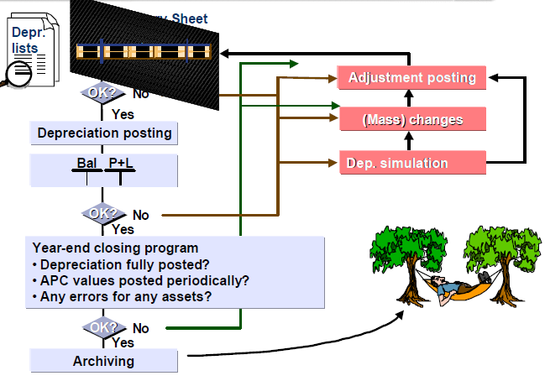
Periodic Processing :FY change and YE closing

Slide 20
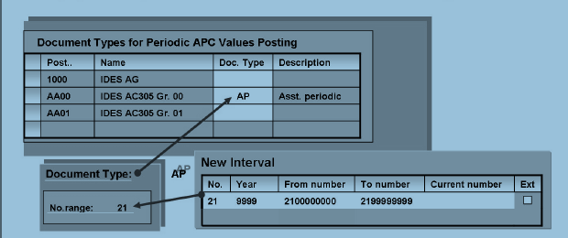
Periodic Processing: Periodic APC value postings
Settings for using RAPERB2000:
Define new document type: Integration with the General Ledger
→ Post Depreciation to the General Ledger → Specify Document Type for
Posting of Depreciation → Define Document Types .
Create number range interval: Choose the Number range information function from above to go directly to maintenance of the number range interval and create a new interval.
Create the new document type for your company codes: Integration with the General Ledger → Post APC Values Periodically to the General Ledger → Specify
Document Type for Periodic Posting of Asset Values.

Slide 21
Periodic Processing :Exercise Time
Post 10,000 on January 01, CY to one of your master records of class -fixtures and fittings where data has not been posted to so far.(If there is none , create one ).Check the planned depreciation shown and the dep key
Change the depreciation terms in depreciation areas 01 and 02 . Analyze the planned book depreciation again in the Asset Explorer. Has the planned depreciation amount changed ?
Check whether all depreciation keys in your Chart of depreciation have the status “Active”. What is the name of the transaction for this?
Do a test run of the year-end program for your company code for the previous year. Does that give error ?
Complete all the activities which are not yet done including Fiscal year close and APC postings -RAPERB2000. Again do a test run for Year end closing .

Slide 22

Asset Accounting : Periodic Processing
Summary:
You should now be able to :
Analyze depreciation values
Initiate the depreciation posting run
Explain the tasks of the fiscal year change and year end closing

Slide 23
Asset Accounting
Information system /Reporting
Periodic processing
Asset Transactions
Master data
Organization structure

Slide 24
Asset Accounting: Information System
Objective:
After completing this unit, you will be able to :
Choose and execute the various Asset accounting reports
Set up variable sorting and totaling for Asset reporting
Create the Asset history sheet and structure it to meet your needs
Generate a depreciation forecast
Simulate depreciation for Assets

Slide 25
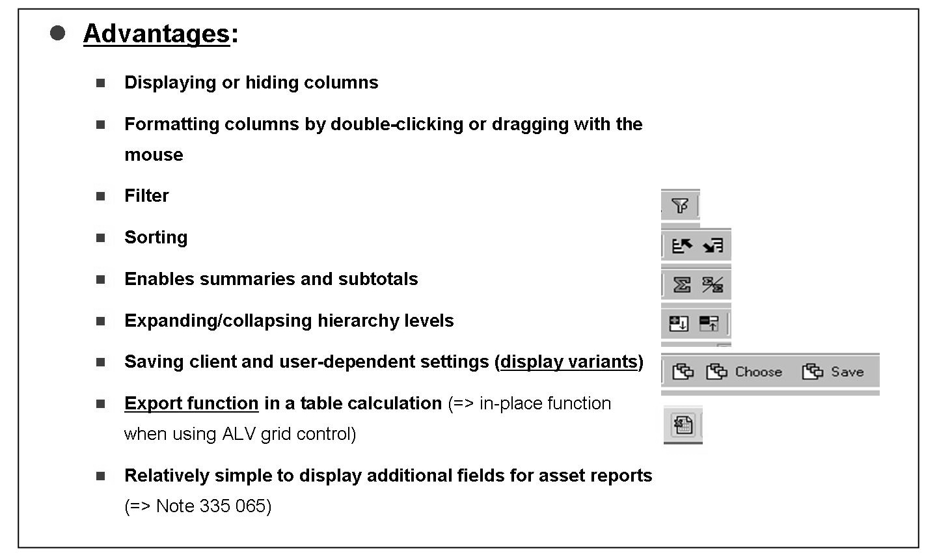
Information System: AA Area Menu
The area menu for reporting is called FIAA Information System Asset Accounting. This is embedded in the Asset Accounting area menu (ASMN).

Slide 26
Information System: ABAP list viewer
All line items are evaluated by the ABAP List Viewer. Its user-friendly characteristics support the dynamic creation of layouts.
The new graphical design makes it even simpler to process and display lists and reports using the List Viewer grid control. Important List Viewer functions:
Deleting and inserting columns
Arranging the values in columns in ascending or descending order
Calculating totals or subtotals across one or more columns within a list
Using layouts to save an individual report structure so that you can use it again later
Setting filters: It is possible to display only those line items that have some connection with a particular criterion
All reports allow you to sort/total data in different ways using freely definable sort criteria

Slide 27
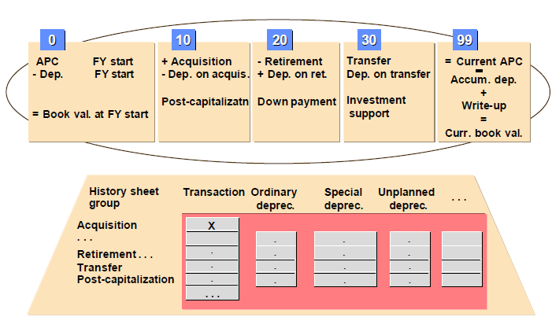
Information System: Asset history sheet
The asset history sheet is the most comprehensive year-end report or intermediate report. You can create it using any sort versions, and with totals at any group level, just like any other report. You can create a compact totals list that does not contain information on the individual assets.
By using report interfaces, you can display the history sheet for the individual assets that form the total. You can drill down to the asset value display.
Different reports can be called up from other SAP R/3 components.SAP supplies country-specific versions of the asset history sheet. These meet the legal requirements in the given country. There are also additional history sheet versions (to display the development of special depreciation).

Slide 28
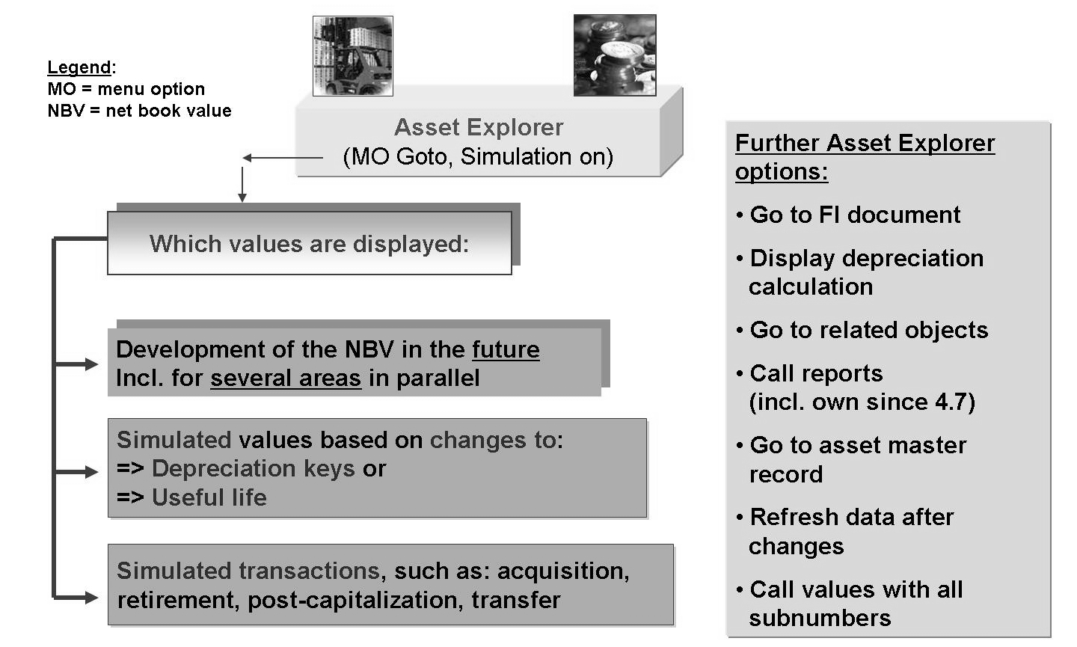
Information System :Asset Explorer
Asset Explorer offers extensive possibilities for evaluating individual asset master records.

Slide 29
Information System: Asset Explorer
Choose Display dep. calc. to see a detailed display of the calculation of depreciation in the system.
The Posted Values tab page displays not only the planned data for a fiscal year, but also the amounts actually posted to date.
Asset Explorer can also be used to create a preview of how the values for individual assets will develop by means of simulated transactions and/or simulated depreciation terms
You can start reports from within the Asset Explorer. You can also create your own report variants for these reports by choosing Goto →Maintain Reports.

Slide 30
Information System : Depreciation simulation
When you simulate the development of asset values, you can change all the important depreciation terms using a simulation version and simulate the depreciation for future fiscal years.
Sort versions and the options for a totals report are also available.
In the forecast depreciation for your planned capital investments can also be included . In order to take advantage of this option, you have to be managing the planned investment amounts as planned costs on an order or project in CO.
By assigning depreciation terms and a planned start-up date to the order or project, you make it possible for the planned depreciation to be displayed.
From the list, asset value display of each selected asset can be drilled down .The evaluation date is relevant for the value display.

Slide 31
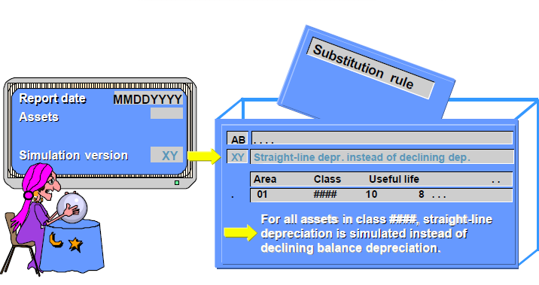
Information System : Depreciation simulation
Simulation versions allow you to simulate a change in depreciation method for asset value/depreciation reports.
For each area, asset class, and depreciation key, specify which depreciation key and useful life should be chosen as alternatives for simulation. The validity interval excludes assets with a capitalization date that lies outside that range.
A substitution rule can also be defined to include other depreciation parameters in the simulation.

Slide 32
Information System :Exercise Time
Create a list of all (posted) assets of your company code, sorted and totaled according to cost center. Use SAP Mail to send this list to any other user.
Change an asset list of your company code, so that the assets of the company code are listed by acquisition value in descending order . Save these settings in a (user-specific) display variant / a(user-specific) layout and then try to call the variant again.
Request the asset sheet history (RAGITT_ALV01) and using sort version 13 and history sheet version 0001, display all assets of your company code, first individually, and then as a total.
Post an acquisition to the company car master record(If there is none , create one).Post a value of 50,000 in the first half of the current year (1/1/CY)
Think about reducing the useful life from five to four years , at least in areas 01 and 02. Simulate this change in the Asset Explorer.

Slide 33
Asset Accounting : Information System
Summary :
You should now be able to :
Choose and execute the various Asset accounting reports
Set up variable sorting and totaling for Asset reporting
Create the Asset history sheet and structure it to meet your needs
Generate a depreciation forecast
Simulate depreciation for Assets

Slide 34
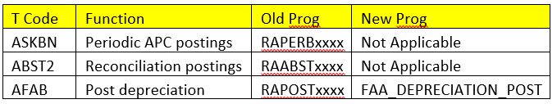
Data Structure Changes in Asset Accounting
Actual data of ANEK, ANEP, ANEA, ANLP, ANLC is now stored in table ACDOCA. ANEK data is stored in BKPF.
Compatibility views FAAV_<TABLENAME> (for example, FAAV_ANEK) are provided in order to reproduce the old structures.
Statistical data (for example, for tax purposes) previously stored in ANEP, ANEA, ANLP, ANLC is now stored in table FAAT_DOC_IT
Plan data previously stored in ANLP and ANLC is now stored in FAAT_PLAN_VALUES
Classic Asset Accounting is mostly transformed automatically into the New Asset Accounting by executing mandatory migration steps related to Asset Accounting.
Following table shows some redundant/new Asset accounting program.

Slide 35
New FI-AA-Integration with the Universal Journal Entry
Asset Accounting is based on the universal journal entry. This means there is no longer any redundant data store, General Ledger Accounting and Asset Accounting are reconciled Key changes are listed below: –
There is no separate balance carry forward needed in asset accounting, the general balance carry forward transaction of FI (FAGLGVTR) transfers asset accounting balances by default.
The program Fixed Assets-Fiscal Year Change (RAJAWE00) transaction AJRW is no longer has to be performed at fiscal year change
The most current planned depreciation values will be calculated automatically for the new year after performing the balance carry forward. The depreciation run posts the pre-calculated planned values.
The Selection screen is simplified as the “reasons for posting run” (planned depreciation run, repeat, restart, unplanned posting run) are no longer relevant.
Errors with individual assets do not necessarily need to be corrected before period-end closing; period-end closing can still be performed. You have to make sure that all assets are corrected by the end of the year only so that depreciation can be posted completely.
All APC changes in Asset Accounting are posted to the general ledger in real time. Periodical APC postings are therefore no longer supported.
Transaction types with restriction to depreciation areas are removed in new Asset Accounting and you can set the obsolete indicator in the definition of the transaction that were restricted to depreciation areas in the classic asset accounting.

Slide 36
Key Configuration Consideration in Ledger Approach
We need to answer some basic question before configuring new asset accounting in S4 Hana environment as this would determine the required minimum depreciation areas to align the FI with Asset Accounting. i.e.
Required Valuation Approach
How Many Ledgers (Leading + Non Leading) exists or to be configured.
What all currencies are used in each of the ledgers.

Slide 37
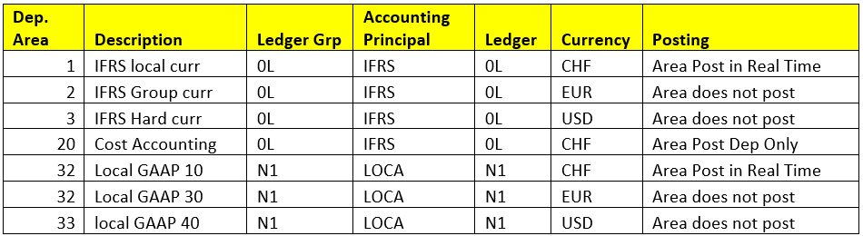
Key Configuration Consideration in Ledger Approach
For Example:-
In this Example we have one com code which has 2 ledgers 0L & N1 & these 2 ledgers having 3 currencies i.e 10,30 & 40 as shown below.
Above mapping is to ensure and establish link between depreciation area/accounting principal and Currency
Explaining with ledger approach example. From release 1503 i.e initial version of SAP Finance add on version in S4 Hana a new table ACDOCA is introduced which stores the asset values also per ledger /per currency on real time basis & no need to have any reconciliation between Finance and Asset accounting and to do so it is must to follow the guidelines while setting up depreciation areas & respective currencies

Slide 38
Why will use a technical clearing GL account
Architecture has been changed in the way that we now post in asset accounting for each valuation a separate document. So we perform on the asset part accounting principle specific postings. Technically we perform ledger-groups specific postings.
On the operational part (accounts receivable, accounts payable) the value is always the same for each accounting principle. So for the operational part we have to perform postings which are valid for all accounting principles. Technically we perform postings without specifying the ledger-group.
To split the business process in an operational and a valuating document there was a need to establish the “technical clearing account” for integrated asset acquisition.
For the operational part (vendor invoice/GRIR), the system posts a document valid for all accounting principles against the technical clearing account for integrated asset acquisitions. From a technical perspective, the system generates a ledger-group-independent document.
For each valuating part (asset posting with capitalization of the asset), the system generates a separate document that is valid only for the given accounting principle. This document is also posted against the technical clearing account for integrated asset acquisitions. From a technical perspective, the system generates ledger-group-specific documents.

Slide 39
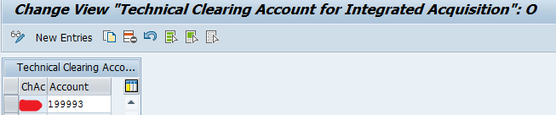
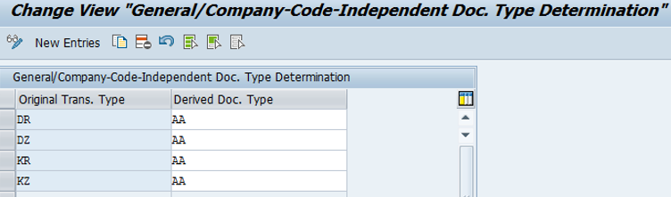
Define account “Technical clearing account” for integrated asset acquisition.
Specify Alternative Document Type for Accounting Principle-Specific Documents
Here Operational document type will have original document used during entry & while generating accounting principal wise separate document it would be document type AA.

Slide 40
New Asset Accounting Posting Logic
The Operational Entry Document posts to a technical clearing account. The Operational Entry Document does not update the asset values; the asset data is only used to perform checks.
Accounting principle specific documents (1 to n). The accounting principle specific documents post to: – the technical clearing account in each view (balancing to zero) and the asset reconciliation account (and update the asset line items).

Slide 41
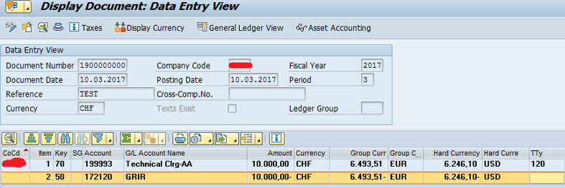
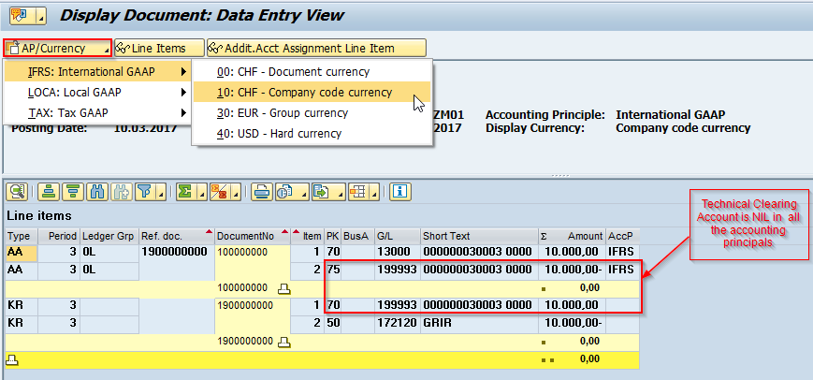
Asset Acquisitions Operational Document
Asset Acquisitions Accounting Principal (IFRS) specific Document

Slide 42
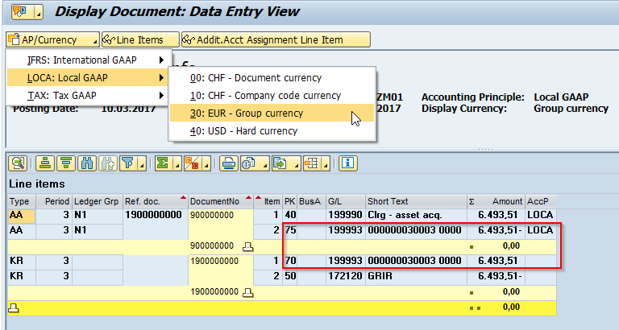
Asset Acquisitions Accounting Principal (LOCA) specific document

Slide 43
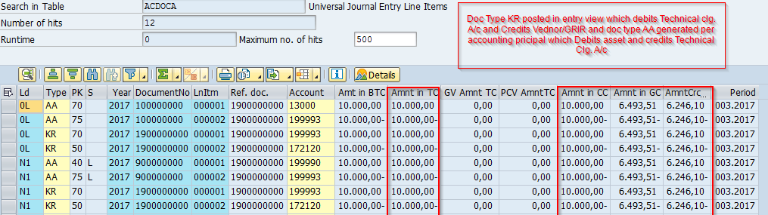
Universal Table updated with respective ledger (0L & N1) and currencies.

